Slide 1
Lecture: Dictionaries and Mutable Data

Slide 2
Maps Project Next Week!
Partner Project
See thread on Ed
"Phases" break the project down:
Phases 0 and 1 are easier than 2 and 3.
Checkpoint Weds 2/28
Worth 4/40 points, you need to make progress on Phase 0 and 1 (easier parts)
Final Deadline Mar 8 (Mon)

Slide 3
Dictionaries
Notes:
3

Slide 4
Learning Objectives
Dictionaries are a new type in Python
Lists let us index a value by a number, or position.
Dictionaries let us index data by other kinds of data.

Slide 5
Dictionaries
Constructors:
dict( <list of 2-tuples> )
dict( <key>=<val>, ...) # like kwargs
{ <key exp>:<val exp>, … }
{ <key>:<val> for <iteration expression> }
>>> {x:y for x,y in zip(["a","b"],[1,2])}
{'a': 1, 'b': 2}
Selectors: <dict>[ <key> ]
<dict>.keys(), .items(), .values()
<dict>.get(key [, default] )
Operations:
Key in, not in, len, min, max
<dict>[ <key> ] = <val>

Slide 6
Demo
person = { 'name': 'Michael' }
person.get('name')
person['email'] = 'ball@berkeley.edu'
person.keys()
'phone' in person
text = 'One upon a time'
{ word : len(word) for word in text.split() }

Slide 7
Mutability

Slide 8
Learning Objectives
Distinguish between when a function mutates data, or returns a new object
Many Python "default" functions return new objects
Understand modifying objects in place
Python provides “is” and “==” for checking if items are the same, in different ways

Slide 9
Why does Mutability Matter?
Mutable data is a reality — lists, dictionaries, objects (coming soon)
It's a challenging aspect of programming
There are common patterns, which you will slowly become familiar with and internalize.
Use your environment diagrams!

Slide 10
Objects in Python
An object is a bundle of data and behavior.
A type of object is called a class.
Every value in Python is an object.
string, list, int, tuple, et
All objects have attributes
Objects often have associated methods
lst.append(), lst.extend(), etc
Objects have a value (or values)
Mutable: We can change the object after it has been created
Immutable: We cannot change the object.
Objects have an identity, a reference to that object.

Slide 11
Immutable Object: string
course = 'CS88'
What kind of object is it?
type(course)
What data is inside it?
course[0]
course[2:]
What methods can we call?
course.upper()
course.lower()
None of these methods modify our original string.

Slide 12
Dictionaries are Mutable, too
Mutable Objects: lists and dictionaries
Immutable – the value of the object cannot be changed
integers, floats, booleans
strings, tuples
Mutable – the value of the object can change
Lists
Dictionaries
>>> adict = {'a':1, 'b':2}
>>> adict
{'b': 2, 'a': 1}
>>> adict['b']
2
>>> adict['b'] = 42
>>> adict['c'] = 'elephant'
>>> adict
{'b': 42, 'c': 'elephant', 'a': 1}
>>> alist = [1,2,3,4]
>>> alist
[1, 2, 3, 4]
>>> alist[2]
3
>>> alist[2] = 'elephant'
>>> alist
[1, 2, 'elephant', 4]

Slide 13
Dictionaries – by example
Dictionaries
Constructors:
dict( hi=32, lo=17)
dict([('hi',212),('lo',32),(17,3)])
{'x':1, 'y':2, 3:4}
{wd : len(wd) for wd in "The quick brown fox".split()}
Selectors:
water['lo']
<dict>.keys(), .items(), .values()
<dict>.get(key [, default] )
Operations:
in, not in, len, min, max
'name' in course
Mutators
course['number' ] = 'C88C'
course.pop('room')
del course['room']

Slide 14
Immutability vs Mutability
An immutable value is unchanging once created.
Immutable types (that we've covered): int, float, string, tuple
a_string = "Hi y'all"
a_string[1] = "I" # ERROR
a_string += ", how you doing?"
an_int = 20
an_int += 2
A mutable value can change in value throughout the course of computation. All names that refer to the same object are affected by a mutation.
Mutable types (that we've covered): list, dict
grades = [90, 70, 85]
grades_copy = grades # Not actually a copy!
grades[1] = 100 # grades_copy changes too!
words = {"agua": "water"}
words["pavo"] = "turkey"

Slide 15
From value to storage …
Mutation in Environments
A variable assigned a compound value (object) is a reference to that object.
Mutable objects can be changed but the variable(s) still refer to it
x is still the same object, but it's values have changed.
x = [1, 2, 3]
y = 6
x[1] = y
x[1]
frame
1
•
2
6
•
3
•
x:
•
y:
6
…

Slide 16
Mutating Lists: Example functions of the list class
append() adds a single element to a list:
s = [2, 3]
t = [5, 6]
s.append(4)
s.append(t)
t = 0
Try in PythonTutor.
extend() adds all the elements in one list to another list:
s = [2, 3]
t = [5, 6]
s.extend(4) # 🚫 Error: 4 is not an iterable!
s.extend(t)
t = 0
Try in PythonTutor. (After deleting the bad line)

Slide 17
Mutating Lists -- More Functions!
list += [x, y, z] # just like extend.
You need to be careful with this one! It modifies the list.
pop() removes and returns the last element:
s = [2, 3]
t = [5, 6]
t = s.pop()
Try in PythonTutor.
remove() removes the first element equal to the argument:
s = [6, 2, 4, 8, 4]
s.remove(4)
Try in PythonTutor.

Slide 18
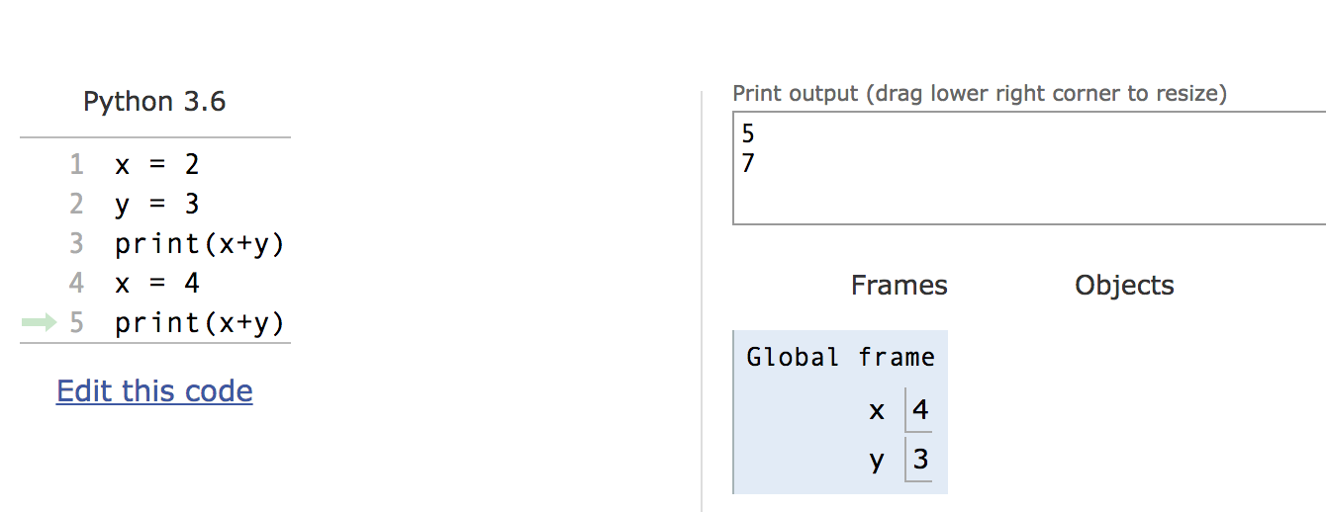
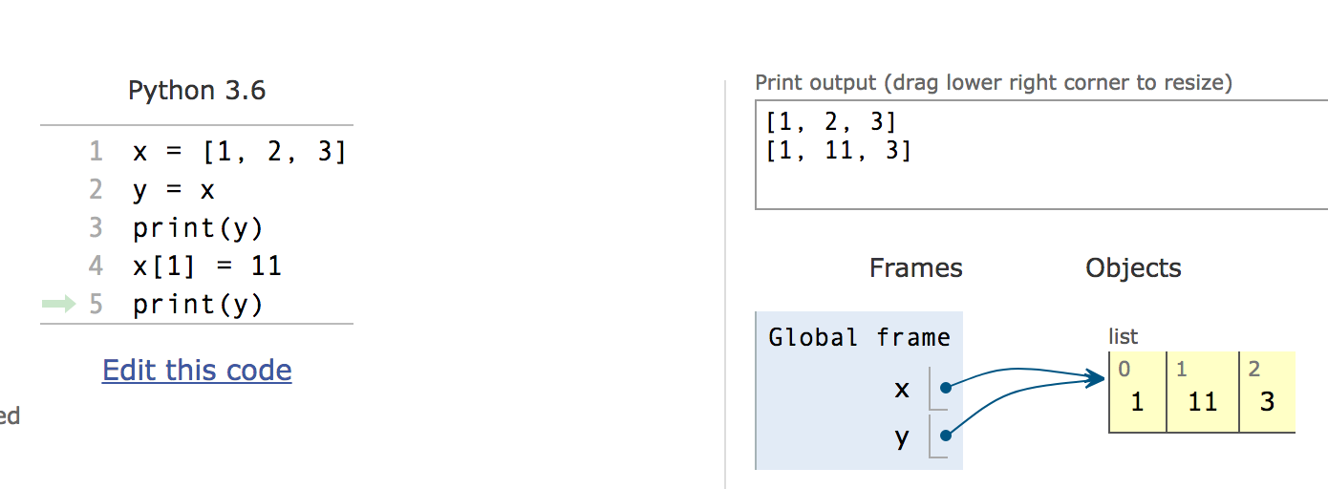
Mutation makes sharing visible
Python Tutor: Assignments Are References

Slide 19
Mutable Data Inside Immutable Objects
Mutable objects can "live" inside immutable objects!
An immutable sequence may still change if it contains a mutable value as an element.
Be very careful, and probably do notdo this!
t = (1, [2, 3])
t[1][0] = 99
t[1][1] = "Problems"
Try in PythonTutor

Slide 20
Equality vs Identity
list1 = [1,2,3]
list2 = [1,2,3]
Equality: exp0 == exp1 evaluates to True if both exp0 and exp1 evaluate to objects containing equal values (Each object can define what == means)
list1 == list2 # True
Identity: exp0 is exp1 evaluates to True if both exp0 and exp1 evaluate to the same object
Identical objects always have equal values.
list1 is list2 # False
Try in PythonTutor.

Slide 21
Copies, 'is' and '=='
Identity and == vs is
How do we know if two names (variables) are the same exact object? i.e. Will modifying one modify the other?
>>> alist = [1, 2, 3, 4]
>>> alist == [1, 2, 3, 4] # Equal values?
True
>>> alist is [1, 2, 3, 4] # same object?
False
>>> blist = alist # assignment refers
>>> alist is blist # to same object
True
>>> blist = list(alist) # type constructors copy
>>> blist is alist
False
>>> blist = alist[ : ] # so does slicing
>>> blist is alist
False
>>> blist
[1, 2, 3, 4]
>>>

Slide 22
What is the meaning of is?
is in Python means two items have the exact same identity
Thus, a is b implies a == b
Why? Each object has a function id() which returns its "address"
We won't get into what this means, but it's essentially an internal "locator" for that data in memory.
Think of two houses which have the exact same floor plan, look the same, etc. The are "the same house" but each have a unique address. (And thus are different houses)
Think this is tricky? cool? amazing?
Take CS61C (Architecture) and CS164 (Programming Languages)

Slide 23
Passing Data Into Functions

Slide 24
Learning Objectives
Passing in a mutable object in a function in Python lets you modify that object
Immutable objects don't change when passed in as an argument
Making a new name doesn't affect the value outside the function
Modifying mutable data does modify the values in the parent frame.

Slide 25
Mutating Arguments
Functions can mutate objects passed in as an argument
Declaring a new variable with the same name as an argument only exists within the scope of our function
You can think of this as creating a new name, in the same way as redefining a variable.
This will not modify the data outside the function, even for mutable objects.
BUT
We can still directly modify the object passed in…even though it was created in some other frame or environment.
We directly call methods on that object.
View Python Tutor

Slide 26
Understanding Python: What should we return?
Why do some functions return None?
Why do some functions return a value?
Functions that mutate an argument usually return None!
C88C / 61A / Data Science View: Avoid mutating data unless it's necessary!
Mutations are useful, but can get confusing quickly. This is why we focus on functional programming - map, filter, reduce, list comprehensions, etc.

Slide 27
Functions that Mutate vs Return New Objects
Lists:
sorted(list) – retiurns a new list
list.sort() – modifies the list, returns None
list.append() – modifies the list, returns None
list.extend() – modifies the list, returns None

Slide 28
Python Gotcha's: a += b and a = a + b
Sometimes similar looking operations have very different results!
Why?
= always binds (or re-binds) a value to a name.
Python Tutor
def add_data_to_thing(thing, data):
print(f"+=, Before: {thing}")
thing += data
print(f"+=, After: {thing}")
return thing
def new_thing_with_data(thing, data):
print(f"=, Before: {thing}")
thing = thing + data
print(f"=, After: {thing}")
return thing

Slide 29
Mutable Functions

Slide 30
Learning Objectives
Remember: Each function gets its own new frame
Inner functions can access data in the parent environment
Use an inner function along with a mutable data type to capture changes

Slide 31
Making Functions that Capture and change state
We want to make a function, which returns a function that can change the state.
Python Tutor Link
def make_counter():
counter = [0]
def count_up():
counter[0] += 1
return counter
return count_up
c = make_counter()
print(c)
c()
c()
c()

Slide 32
Functions with Changing State
Goal: Use a function to repeatedly withdraw from a bank account that starts with $100.
Build our account: withdraw = make_withdraw_account(100)
First call to the function:
withdraw(25) # 75
Second call to the function:
withdraw(25) # 50
Third call to the function:
withdraw(60) # 'Insufficient funds'

Slide 33
How Do We Implement Bank Accounts?
A mutable value in the parent frame can maintain the local state for a function.
View in PythonTutor
def make_withdraw_account(initial):
balance = [initial]
def withdraw(amount):
if balance[0] - amount < 0:
return 'Insufficient funds'
balance[0] -= amount
return balance[0]
return withdraw

Slide 34
Implementing Bank Accounts
A mutable value in the parent frame can maintain the local state for a function.
def make_withdraw_account(initial):
balance = [initial]
def withdraw(amount):
if balance[0] - amount < 0:
return 'Insufficient funds'
balance[0] -= amount
return balance[0]
return withdraw
View in PythonTutor

